Slide 1
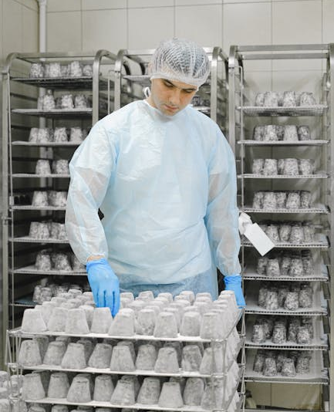
Quality and Reliability in the Food Industry
Presented By: Gulshan Puthukkattu Mansoor Ahamed
Shebina Baby
Chippy Chandra Pillai
Harminder

Slide 2
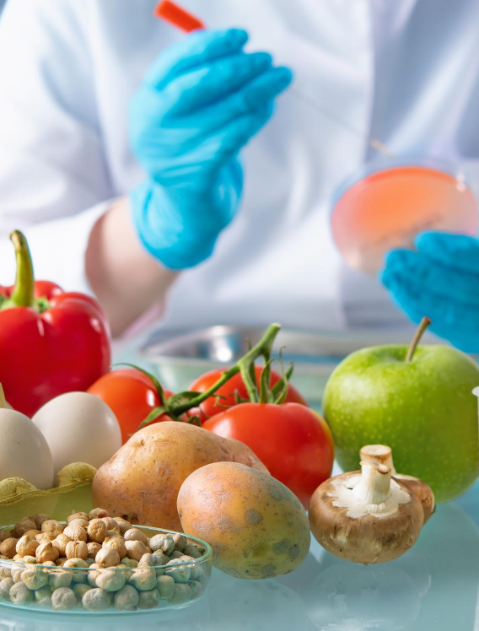
Introduction
This project aims to analyze the key factors affecting product reliability and evaluate food quality assurance techniques used in the food industry, focusing on Valio, one of the largest dairy producers in Finland.

Slide 3
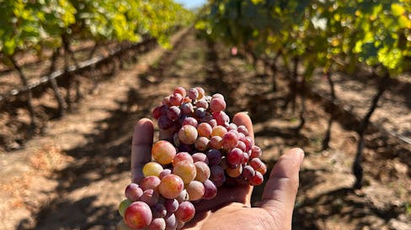
Key Factors Impacting Quality
QUALITY CONTROL AND ASSURANCE
Effective quality control measures are vital in ensuring the integrity and safety of food products. These include systematic monitoring at each production stage and integration of preventive techniques.
Management involves rigorous systems, practices, and standards for consumer expectations
REGULATORY COMPLIANCE AND RELIABILITY
Compliance with industry regulations forms the backbone of consumer trust. Food companies must prioritize adherence to safety and operational regulations to maintain reliability.

Slide 4

Valio: Company Overview
HISTORY AND MARKET POSITION
Valio, founded in 1905, is a leading dairy producer in Finland. It holds a significant market share due to its commitment to quality and innovation in dairy products.
KEY PRODUCTS OFFERED
Valio's product range includes milk, cheese, butter, and lactose-free options. Their focus on quality and health benefits sets them apart in the competitive market.

Slide 5
Valio's Quality Assurance Strategies
SYSTEMATIC TESTING PROCEDURES
RAW MATERIAL SOURCING
COMMITMENT TO EMPLOYEE TRAINING
Valio implements rigorous testing protocols at all production stages, including microbiological checks and shelf-life testing to ensure product safety.
By sourcing milk from a network of over 3,400 farms, Valio guarantees high-quality raw materials. Strict testing and sustainable practices govern this sourcing.
Ingraining a quality culture among employees is a focus at Valio. Comprehensive training leads to enhanced workplace safety and reduced absenteeism.

Slide 6
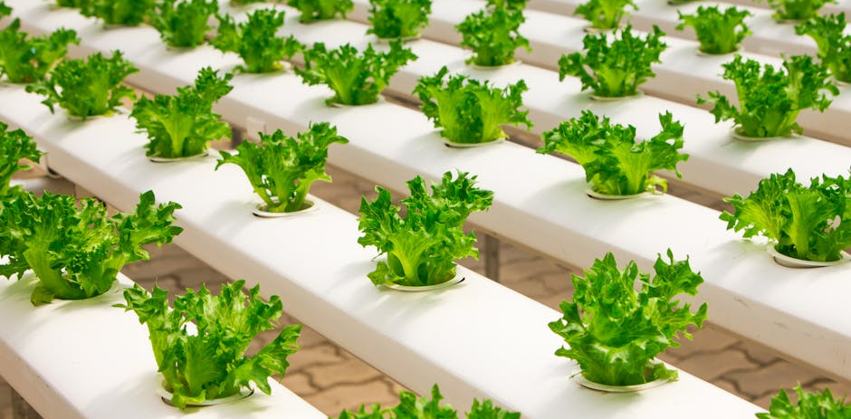
Technological Integration at Valio
IOT FOR MONITORING
Valio employs IoT sensors for real-time monitoring of production parameters, which significantly reduces chances of contamination and improves accuracy.
BLOCKCHAIN FOR TRACEABILITY
The integration of blockchain technology at Valio enhances product traceability, ensuring transparency and accountability throughout the supply chain.

Slide 7
Sustainability Initiatives
35%
40%
25%
RECYCLED PACKAGING
CARBON FOOTPRINT REDUCTION
RENEWABLE ENERGY USE
Valio uses recycled materials for packaging to reduce waste.
Sustainable practices aim to lessen overall carbon emissions.
Valio incorporates renewable energy in production.

Slide 8
Development Strategies for Valio
This table summarizes potential strategies for improving Valio's quality and reliability management.
STRATEGY | DESCRIPTION | EXPECTED OUTCOME
Adopting TQM and Six Sigma | Implement advanced methodologies to reduce defects. | Higher product quality and efficiency.
Implementing Advanced Analytics | Use predictive analytics to foresee equipment failures. | Minimized downtime and improved maintenance.
Improved Supplier Management | Strengthen relationships and set quality standards. | Enhanced quality of raw materials.
Increased Customer Feedback | Engage customers in product development. | Greater customer satisfaction and loyalty.

Slide 9
Statistical Improvements
45%
30%
20%
5%
INCREASE IN QUALITY METRICS
RELIABILITY RATINGS STEADY INCREASE
DECREASE IN DEFECT RATES
GROWING CUSTOMER SATISFACTION
Sharp rise since 2015.
Gradual growth over the years.
Substantial reduction achieved.
Improved feedback mechanisms.

Slide 10

Risk and Compliance
VALIO’S RISK MANAGEMENT STRATEGIES
Valio utilizes statistical process controls and failure mode analysis to identify and mitigate risks. This proactive approach ensures consistent product quality.
REGULATORY COMPLIANCE STANDARDS
Valio adheres to ISO 22000, HACCP, and FSSC 22000 standards. This compliance reinforces product safety while maintaining credibility in the industry.

Slide 11
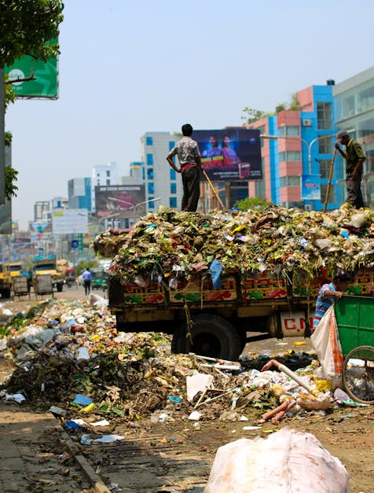
Challenges and Reflections
Implementation of advanced systems may be resource-intensive.
Dependence on technology requires careful management to avoid over-automation.
Sustainability initiatives must balance profitability and environmental responsibility.

Slide 12
Conclusion
Strategic development in Valio's quality and reliability focuses on advanced management systems and technology integration. Expected outcomes are improved operational efficiency, enhanced consumer confidence, and a stronger market position.

Slide 13
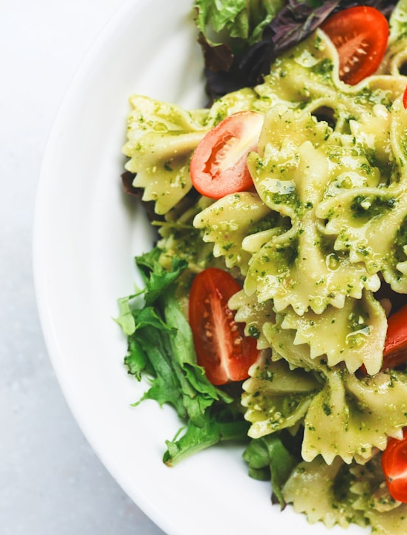
Thank You!

